Slide 1


Hii,
Iam Siddhika
Welcome to Power BI Series
Part -62

Slide 2




I’m very excited to dive into this with you all!
Are you ready to enhance your data visualization skills?
We focus only on the most used and important Visuals
Today Content
VISUALIZING DATA
VISUALS -
LINE CHART
CHANGE OVER TIME
AREA CHART
STACKED AREA CHART

Slide 3
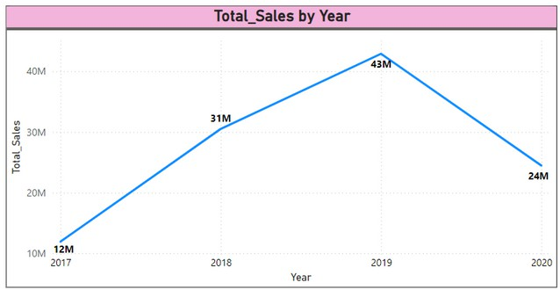


LINE CHART
Go and
explore
formatting
A Line Chart is a type of chart which displays information as a series of data points called 'markers' connected by straight line segments. It is
of Line chart
particularly for showing over time.
useful
When to Use: To visualize trends and changes over time.
To compare multiple series of data.
To identify patterns, peaks, and troughs in data.
trends
Purpose: Line charts are used to track changes over periods of time. They are ideal for data sets that have a sequential nature, like time series data.

Slide 4
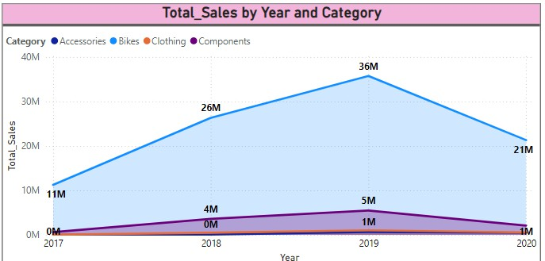


AREA CHART
Go and explore formatting of Area Chart
An Area Chart is
similar to a line chart, but the
area between the line and the axis is filled with color. This visual helps in understanding the
magnitude of change over time and the volume of data.
Purpose: Area charts are useful for displaying the cumulative effect of data over time. They are ideal for showing trends in data where you want to highlight the overall volume.
When to Use: To visualize cumulative totals over time.
To show the magnitude of change over time.
To emphasize the volume of data.

Slide 5
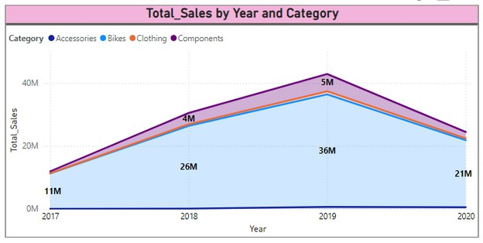

STACKED AREA CHART
Go and explore formatting of stacked area Chart
A Stacked Area Chart is a type of area chart that displays the trend of the contribution of each value over time or other categories. Each series is stacked on top of each other, making it easy to see the total
and individual contributions whole.
parts'
to the
When to Use: To visualize the cumulative total of multiple data series over time.
To show how each data series
Purpose: Stacked Area Charts are used to
contributes to the total over time.
show the part-to-whole relationships over time. They are useful for displaying the
To compare the proportions of
relative different
cumulative effects and how different segments contribute to the whole.
categories over time.

Slide 6

BENEFITS OF STACKED AREA CHARTS
Visualization of Contribution: Clearly see how each category contributes to the total over time.
Comparison Over Time: Easily compare the trends and patterns of different categories over time.
Why waiting just go and explore it?
Highlighting Part-to-Whole Relationships: Emphasize the cumulative effect and the proportion of each category within the total dataset.
BEST PRACTICES
Limit Categories: Too many categories can make the chart cluttered and hard to read. Aim for a manageable number of categories.
Use Consistent Colors: Use distinct and consistent colors for each category to make the chart easy to interpret.
Provide Context: Include labels, legends, and tooltips to give context to the data and make the chart more informative.

Slide 7


Thank you for joining me today to learn about Part -62 of Power BI!
Remember, Effective data visualization is crucial for turning data into meaningful insights and compelling narratives with Power BI.
Stay tuned for more insights and tips on Power BI in our next Series.
Follow
Siddhika Shah

